Slide 1
픈
Exercises for Risk Assessment
Focused on Process Safety Management
Rohan Perera & Han-Gi Kim
Feburary 6, 2020

Slide 2
Workshop # 1
- Process Technology

Slide 3
픈
Memo

Slide 4
픈
Memo

Slide 5
픈
Memo

Slide 6
Workshop # 2
- Process Hazard Analysis

Slide 7
픈
Memo

Slide 8
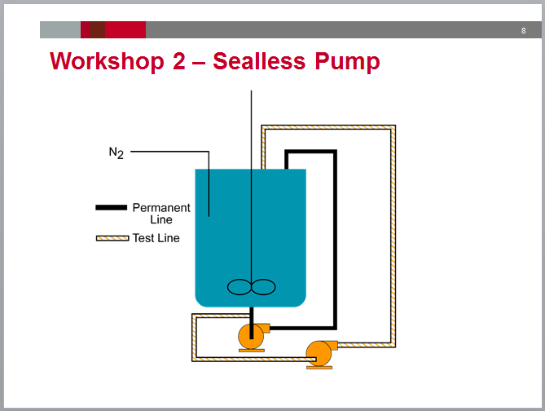
픈
Memo

Slide 9
픈
Memo

Slide 10
Workshop # 3
- Management Of Change-Technology

Slide 11
픈
Memo

Slide 12
픈
Memo

Slide 13
픈
Memo

Slide 14
Workshop # 4
- Quality Assurance

Slide 15
픈
Memo

Slide 16
픈
Memo

Slide 17
Workshop # 5
- Pre-Start up Safety Review (PSSR)

Slide 18
픈
Memo

Slide 19
픈
Memo

Slide 20
Workshop # 6
- Mechanical Integrity (MI)

Slide 21
픈
Memo

Slide 22
픈
Memo

Slide 23
Workshop # 7
- Management Of Change - Subtle

Slide 24
픈
Memo

Slide 25
픈
Memo

Slide 26
Workshop # 8
- Management Of Change - People

Slide 27
픈
Memo

Slide 28
픈
Memo

Slide 29
픈
Memo

Slide 30
픈
Memo

Slide 31
Workshop # 9
- Auditing

Slide 32
픈
Memo

Slide 33
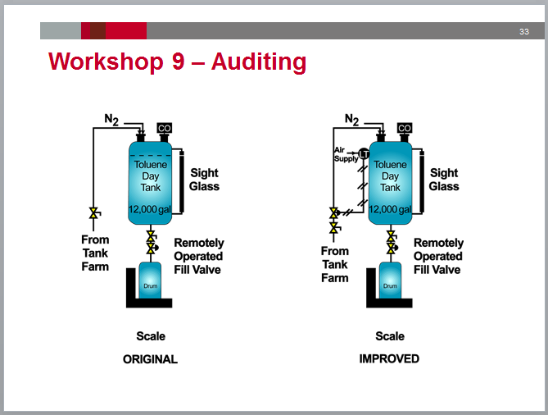
픈
Memo

Slide 34
픈
Memo

Slide 35
픈

